Slide 1

Image Data augmentation through Super Resolution Convolutional Neural Network and Super Resolution Generative Adversarial Network
Doctor of Philosophy
Sofia Amin
Sir Rao Sohail Iqbal
Session:2018-2020
Department: Computer Science

Slide 2


Name
EMAIL@DOMAIN.COM

Slide 3
TABLE OF CONTENTS
Introduction
Problem Background
Problem Statement
Motivation
Research Questions
Research Objectives
Aim and Scope of Research
Literature review
Methodology
Sofia Amin
gghs259rb@gmail.com

Slide 4

1. INTRODUCTION
Sofia Amin
gghs259rb@gmail.com

Slide 5
INTRODUCTION
Deep Learning
Data Augmentation
SRCNN
Patch extraction or representation
Nonlinear mapping
Reconstruction of high resolution images
SRGAN
Generator
Discriminator
Sofia Amin
gghs259rb@gmail.com
1 of 15
Notes:
Write your notes here.
Write here what you will speak during the presentation

Slide 6
2. PROBLEM BACKGROUND
Sofia Amin
gghs259rb@gmail.com

Slide 7
PROBLEM BACKGROUND
Generalizability
Alleviating class imbalance with Data Augmentation
Solution algorithms for test-time augmentation
Developing Software tools
Resolution Impact
Sofia Amin
gghs259rb@gmail.com
2 of 15
Notes:
Write your notes here.
Write here what you will speak during the presentation

Slide 8
3. PROBLEM STATEMENT
Sofia Amin
gghs259rb@gmail.com

Slide 9
PROBLEM STATEMENT
By what means we explore the performance differences across SRCNN and SRGAN architectures with upsampled images such as expanding CIFAR-10 dataset images from 32×32 to 64×64 to 128×128 to 256×256 and so on.
Sofia Amin
gghs259rb@gmail.com
3 of 15
Notes:
Write your notes here.
Write here what you will speak during the presentation

Slide 10
4. MOTIVATION
Sofia Amin
gghs259rb@gmail.com

Slide 11
MOTIVATION
To quote Dr Mithesh Khapra’s words, “Deep Learning is one single technology that is the most prominent technology in machine learning right now, which is being used for a wide variety of task. Since you have a large amount of data coming in, and this being a technology that works well with data — this is the right time for Deep Learning”. I would like to add, this is one technology that can take you “far and deep” into the AI world. (Becoming Human: Artificial Intelligence Magazine).
Another prime area for deep learning is image classification with localization, object detection, object segmentation, image style transfer, image colorization, image reconstruction and image supper resolution. (InfoWorld)
Sofia Amin
gghs259rb@gmail.com
4 of 15
Notes:
Write your notes here.
Write here what you will speak during the presentation

Slide 12
5. RESEARCH QUESTION
Sofia Amin
gghs259rb@gmail.com

Slide 13
RESEARCH QUESTION
How can we explore the performance differences across SRCNN and SRGAN architectures with upsampled images such as expanding CIFAR-10 dataset images from 32×32 to 64×64 to 128×128 to 256×256 and so on?
Sofia Amin
gghs259rb@gmail.com
5 of 15
Notes:
Write your notes here.
Write here what you will speak during the presentation

Slide 14
6. RESEARCH OBJECTIVE
Sofia Amin
gghs259rb@gmail.com

Slide 15
RESEARCH OBJECTIVE
The objective of the research is to identify the better model for producing high resolution output among SRCNN and SRGAN.
Sofia Amin
gghs259rb@gmail.com
6 of 15
Notes:
Write your notes here.
Write here what you will speak during the presentation

Slide 16
7. AIM & SCOPE OF RESEARCH
Sofia Amin
gghs259rb@gmail.com

Slide 17
AIM & SCOPE OF RESEARCH
Aim:
Upsampled the images through SRCNN.
Upsampled the Images through SRGAN.
Comparing the results of both models.
Identify which model produces better results.
Scope:
Focus on Data Augmentation, SRCNN, SRGAN.
Sofia Amin
gghs259rb@gmail.com
7 of 15
Notes:
Write your notes here.
Write here what you will speak during the presentation

Slide 18
8. LITERATURE REVIEW
Sofia Amin
gghs259rb@gmail.com

Slide 19
LITERATURE REVIEW
Image augmentation can be found in LeNet-5 in the shape of data warping. That was the first application of CNN developed for handwritten character recognition or categorization.
In oversampling applications DA has also been played an important role. (Lecun, Bottou, Bengio, & Haffner, 1998)
In medical imaging CNN became more popular since 2012 with the demonstration of dermatologists skin cancer detection.
The neural style transfer (Gatys et al., 2016) was introduced in 2015 and Neural Architecture Search (NAS). (Bello et al., 2017) introduced in 2017.
Neural Augmentation, (Perez & Wang, 2017) and Auto augmented (Perez & Wang, 2017) published in 2017, 2017 and 2018 respectively.
Sofia Amin
gghs259rb@gmail.com
8 of 15
Notes:
Write your notes here.
Write here what you will speak during the presentation

Slide 20
LITERATURE REVIEW
With the advance of Super-Resolution Convolutional Neural Networks presented by (Chong et al. 2014).
Super-Resolution Generative Adversarial Networks, presented by (Ledig et al. 2016).
Kongtaa et-al[2018] the concept of generative adversarial network come from the game theory in which machine is restrict to learn deep representation without extra training.
Kenneth et-al [2019] Deep learning architecture is apply on upto 8X image for calculating super resolution image Super-resolution(GAN) and multi-scale-super- resolution network (MSSRnet) use with the combination of Deep learning architecture to identify small structure inherent in satellite image.
Sofia Amin
gghs259rb@gmail.com
8 of 15
Notes:
Write your notes here.
Write here what you will speak during the presentation

Slide 21
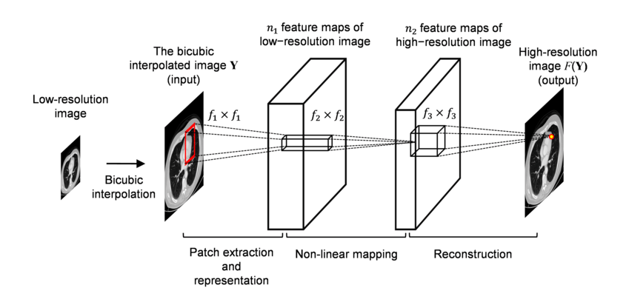
METHODOLOGY
SRCNN Architecture
Sofia Amin
gghs259rb@gmail.com
9 of 15
Notes:
Write your notes here.
Write here what you will speak during the presentation

Slide 22
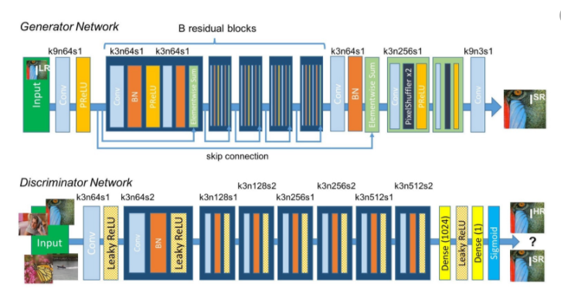
METHODOLOGY
SRGAN Architecture
Sofia Amin
gghs259rb@gmail.com
9 of 15
Notes:
Write your notes here.
Write here what you will speak during the presentation

Slide 23
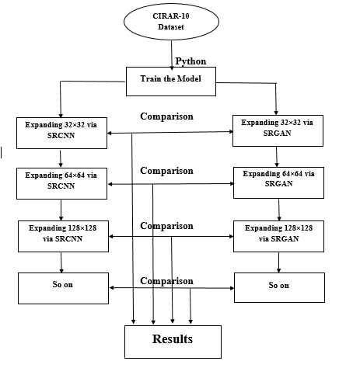
METHODOLOGY
Sofia Amin
gghs259rb@gmail.com
9 of 15
Notes:
Write your notes here.
Write here what you will speak during the presentation

Slide 24

THANK YOU
Sofia Amin
gghs259rb@gmail.com

